Slide 1
Cover Page
Password Manager
Safely Store and Recover Your Passwords
Presented By:
4151 Srijan Juyal
4152 Subham Ghosh
4155 Tanu Kohli
4162 Yash Nikam
4165 Ishu
Under Guidance of:
Prof. Anita Suryawanshi

Slide 2
Cover Page
PROBLEM STATEMENT
In today's digital age, it's becoming increasingly difficult to manage multiple passwords for different accounts.
This is where our project comes in Pass Vault.

Slide 3
Human resources slide 4
OBJECTIVES
One Master Password to access your Credentials
Avoid Reusing Passwords
Save and Manage Passwords for different platforms.
Don’t have to remember all the Passwords
Recover Forgotten Password using Recovery

Slide 4
Cover Page
INTRODUCTION
We aim to create a software using CSS, HTML and JavaScript that will allow users to store their passwords for different accounts and recover them easily if forgotten.
In case the user forgets the super password, we have implemented a system
where they can answer security questions to regain access.

Slide 5
PLAN
Week 1
Week 2
Srijan
Learning encryption techniques
Recovery Test Questions
Subham
Learning html
Login Page
Tanu
Learning Figma
Home Page Design
Yash
Learning Javascript
Password Input
Ishu
Learning Cascading Style Sheet
Home Page Create

Slide 6
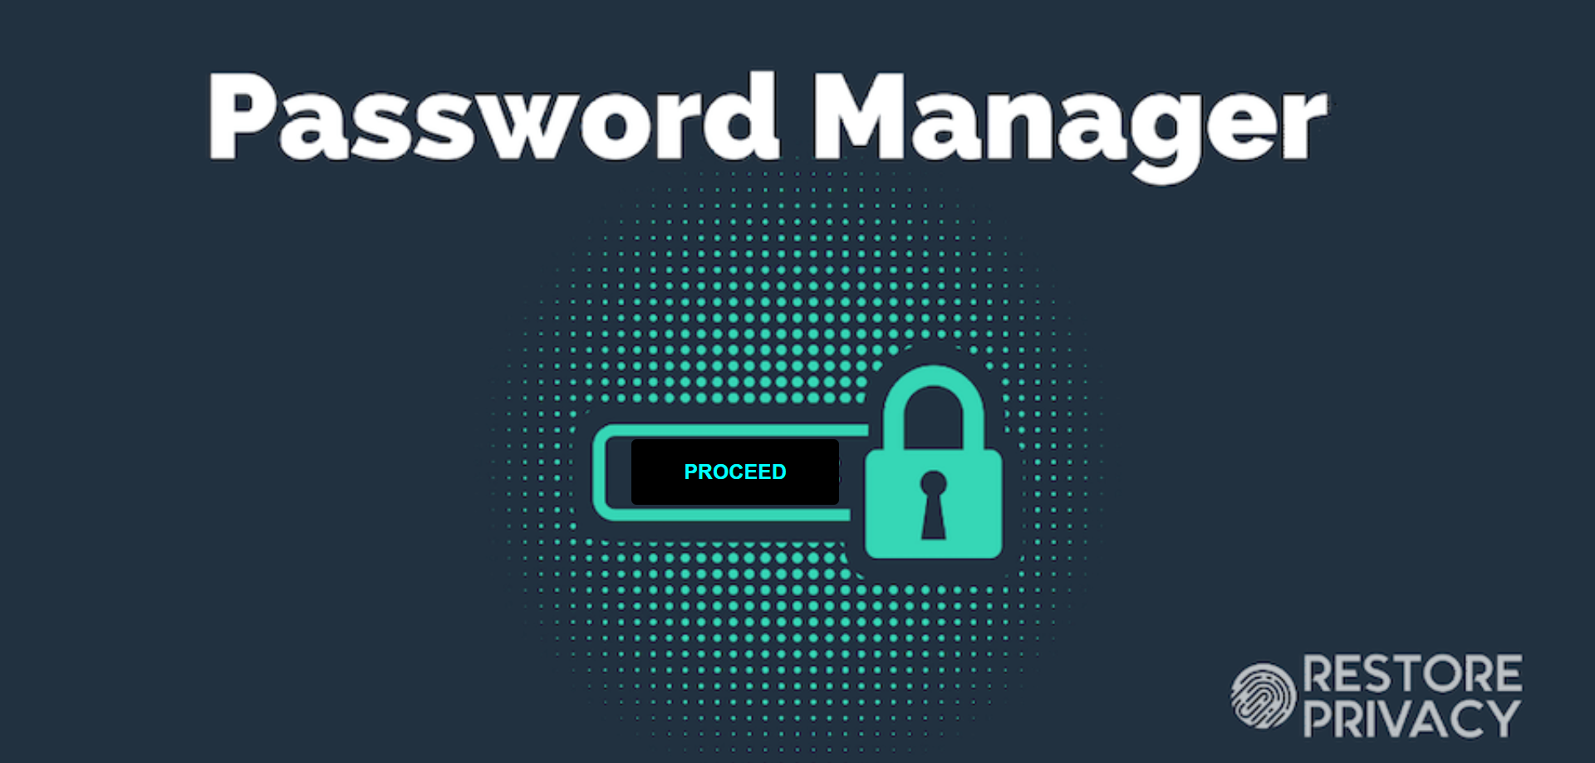
COVER PAGE

Slide 7
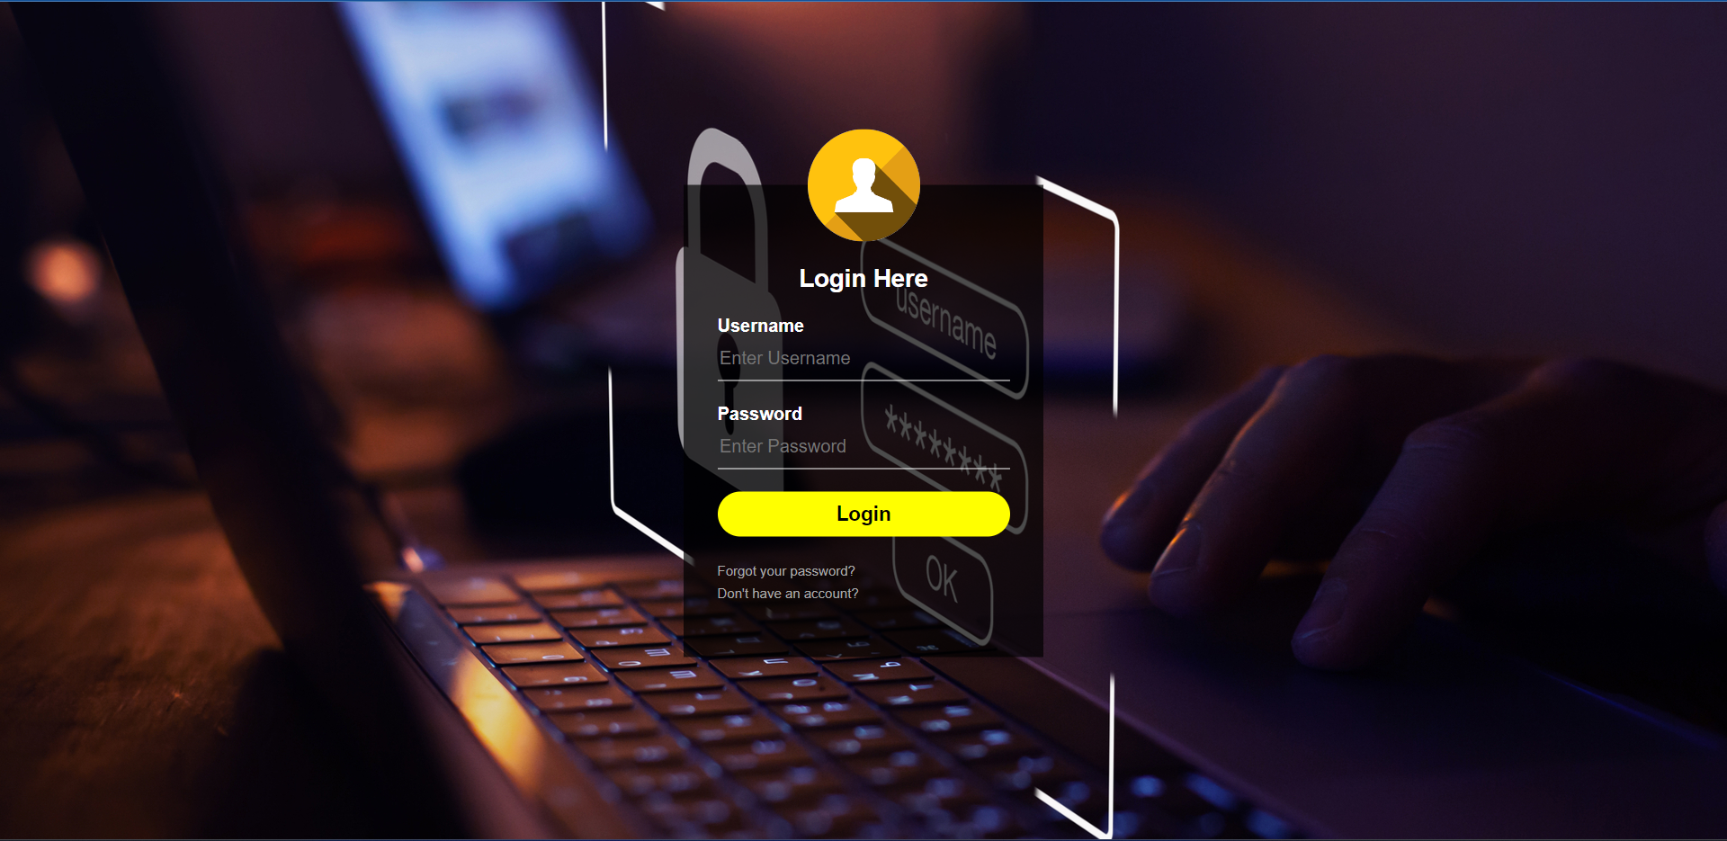
LOGIN PAGE

Slide 8
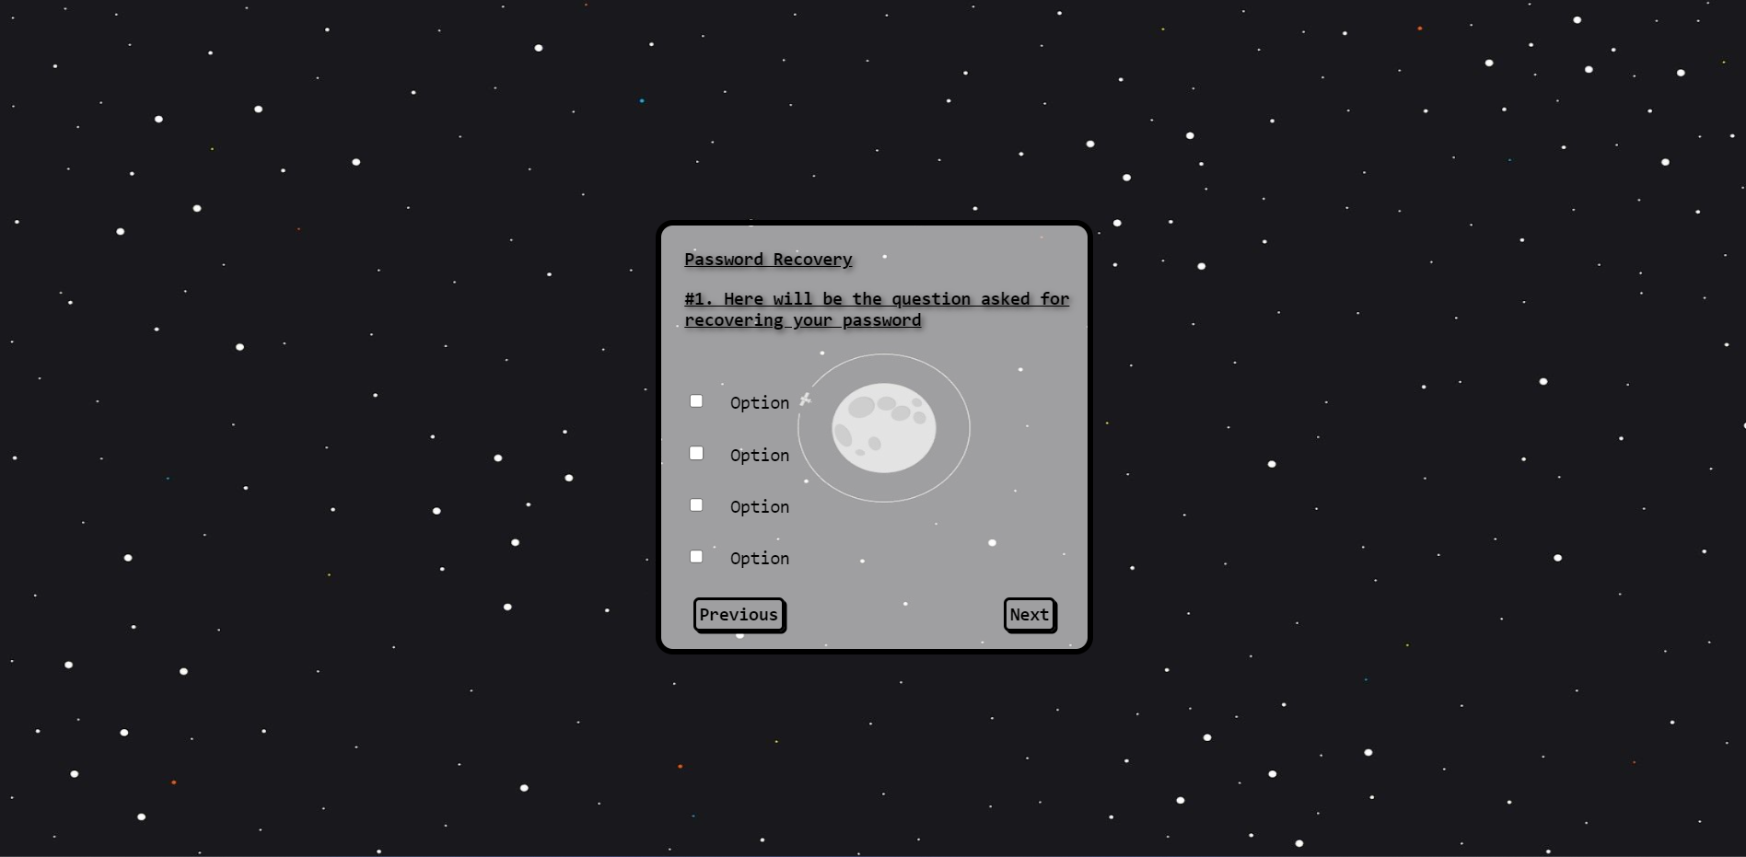
PASSWORD RECOVERY PAGE

Slide 9
PLAN
Week 3
Week 4
Srijan
Encryption Technique 1
Decryption Technique 1
Subham
Reset through forgot password
Question web page 4, 5, 6
Tanu
Recovery Questions apply
Password Matching
Yash
Saved Password Page
Delete Password
Ishu
Questions web page 1, 2, 3
Questions web page 7, 8, 9

Slide 10
PLAN
Week 5
Week 6
#Testing
Srijan
Encryption Technique 2
No. of Password stored
Subham
Question web page 10, 11, 12
Login Testing
Tanu
Question web page 13, 14
Password Recovery Testing
Yash
Password Reconfirmation
Password Encryption Testing
Ishu
Questions web page 15, 16
Low System Specs Testing

Slide 11

Human resources slide 3
FIGMA
For designing of web pages.
TECHNOLOGY
VISUAL STUDIO CODE
For HTML, CSS and JavaScript

Slide 12

Human resources slide 8
PASSWORD ENCRYPTION
Two different words → no same hash
Hash Value → hard to decode
Input
Hash Value
Fox
hashing
DECD 3454 BBEA 788A 751A
696C 24D9 7009 C.A99 2D17
The red fox
hashing
0086 46BB EB7D CBE2 823C
ACC7 6CD1 90B1 EE6E 3ABC
The red Fox
hashing
8FD8 7558 7851 4F32 DIC6
76B1 79A9 ODA4 AEFE 4819

Slide 13
Human resources slide 6
EXPECTED OUTCOME
To create a software which will provide following or relate closely to provide
free password storing
and recovery
with maximum possible security.

Slide 14




Human resources slide 9
References
Youtube:-
Code with Harry
Theoretically
Apna college
Books
Applied Cryptography Protocols Algorithms and Source Code in C by Schneier, Bruice
Websites:-
picoctf.org
google.com

Slide 15
Human resources slide 5
FUTURE ASPECTS
In the future, we could integrate additional features such as
password strength analysis
automatic password generation
upgrade encryption techniques
Improve database security

Slide 16
Human resources slide 6
CONCLUSION
In conclusion, our project aims to address the growing need for secure and convenient password management in today's digital landscape.
We believe that our project has the potential to make a positive impact on the lives of countless people, by providing a simple yet effective solution to a common problem.

Slide 17
Human resources slide 10
Thank You

